Slide 1
Types of Films
Project f.i.l.m.

Slide 2
Crime
crime that is being committed or was committed
Often falls into the action or adventure genres
Notes:
A crime story is about a crime that is being committed or was committed. It can also be an account of a criminal's life. It often falls into the action or adventure genres.

Slide 3
Detective
A story about a detective, either professional or amateur
Protagonist must figure out who committed the crime
Notes:
A story about a detective or person, either professional or amateur, who has to solve a crime that was committed. They must figure out who committed the crime and why. Sometimes, the detective must figure out 'how' the criminal committed the crime if it seems impossible.

Slide 4
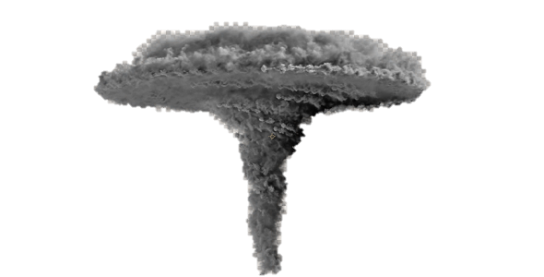
Disaster
A story about mass peril
Protagonist’s job is to survive
Notes:
A story about mass peril, where the protagonist's job is to both survive, and to save many other people from a grim fate, often a natural disaster such as a storm or volcanic eruption, but which may also be a terrorist attack or epidemic of some sort

Slide 5
Documentary
Nonfictional motion picture
Documents some aspect of reality
Notes:
A documentary film is a nonfictional motion picture intended to document some aspect of reality, primarily for the purposes of instruction, education, or maintaining a historical record

Slide 6
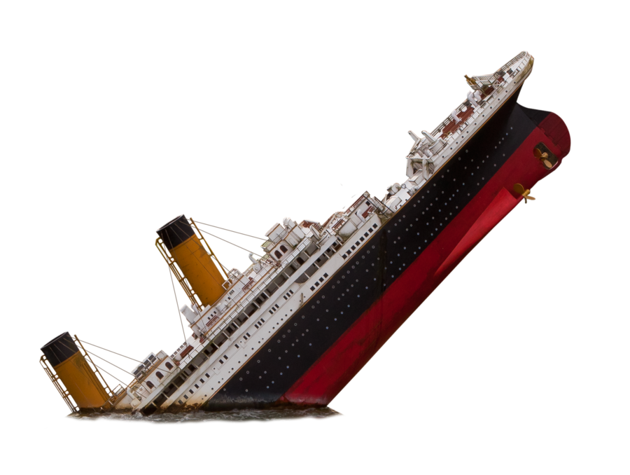
Drama
narrative fiction
intended to be more serious than humorous in tone
Notes:
Drama is a genre of narrative fiction intended to be more serious than humorous in tone, focusing on in-depth development of realistic characters who must deal with realistic emotional struggles. A drama is commonly considered the opposite of a comedy.

Slide 7
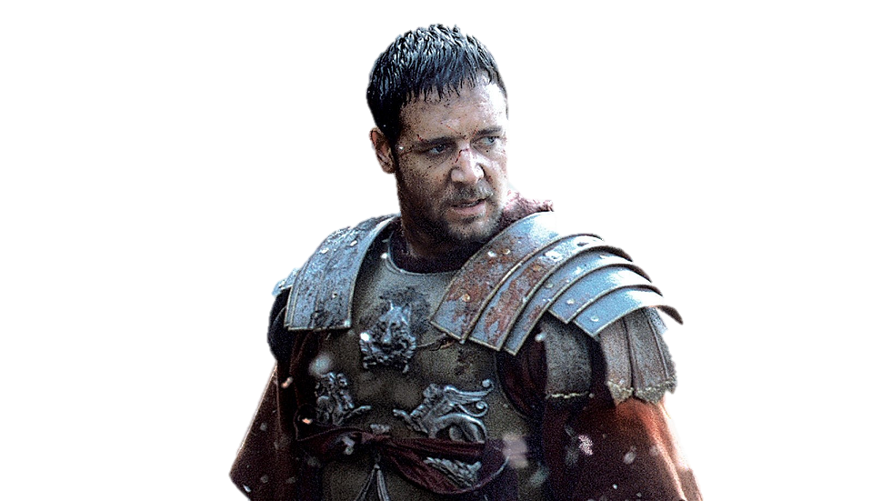
Epics/historical
recreate a historical or imagined event
with an extravagant setting and lavish costumes
Notes:
Epics-Historical Films often recreate a historical or imagined event with a mythic, legendary, or heroic figure, with an extravagant setting and lavish costumes

Slide 8
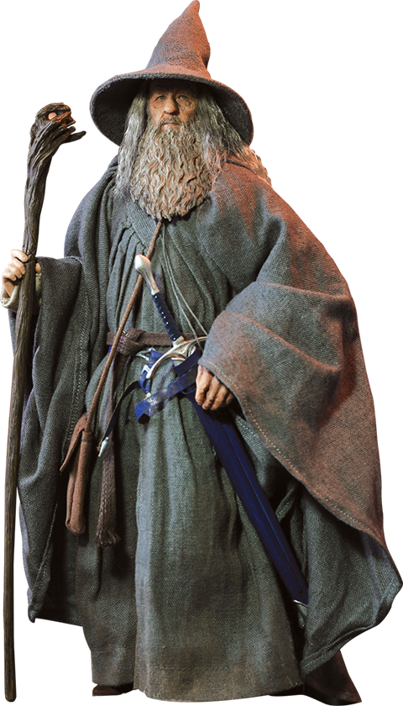
Fantasy
about magic or supernatural forces.
Notes:
A fantasy story is about magic or supernatural forces, rather than technology, though it often is made to include elements of other genres, such as science fiction elements, for instance computers or DNA, if it happens to take place in a modern or future era.

Slide 9
Horror
Has to scare or frighten the audience
Varieties of horror movies:
“Mundanely gruesome”
“Weird tale”
Notes:
A horror story is told to deliberately scare or frighten the audience, through suspense, violence or shock.
H. P. Lovecraft distinguishes two primary varieties of horror movies:
Physical fear or the “mundanely gruesome”
Supernatural Horror story or the “Weird Tale”

Slide 10
Martial arts
Also known as Wuxia
contain numerous martial arts fights between characters
Notes:
AKA Wuxia. It’s a subgenre of the action film. Wuxia films contain numerous martial arts fights between characters. They are usually the films' primary appeal and entertainment value, and often are a method of storytelling and character expression and development.

Slide 11
Musicals/dance
songs sung by the characters are interwoven into the narrative
sometimes accompanied by dancing
Notes:
The musical film is a film genre in which songs sung by the characters are interwoven into the narrative, sometimes accompanied by dancing. The songs usually advance the plot or develop the film's characters, though in some cases they serve merely as breaks in the storyline, often as elaborate "production numbers".

Slide 12
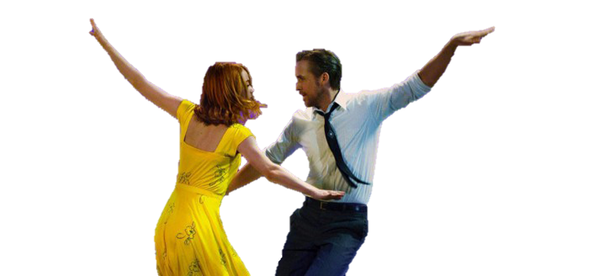
Romance/love story
emotion-driven stories
focuses on the relationship between the main characters of the story
Notes:
Romance novels are emotion-driven stories that are primarily focused on the relationship between the main characters of the story. Beyond the focus on the relationship, the biggest defining characteristic of the romance genre is that a happy ending is always guaranteed.

Slide 13
Romantic comedy
combines the romance genre with comedy
two or more individuals attempt to deal with their romantic love
Notes:
A subgenre which combines the romance genre with comedy, focusing on two or more individuals as they discover and attempt to deal with their romantic love, attractions to each other. The stereotypical plot line follows the "boy-gets-girl", "boy-loses-girl", "boy gets girl back again" sequence.

Slide 14
Science fiction
computers or machines
travel through space, time or alternate universes
alien life-forms
genetic engineering
Notes:
AKA Sci-fi
The science or technology used may or may not be very thoroughly elaborated on; stories whose scientific elements are reasonably detailed, well-researched and considered to be relatively plausible given current knowledge and technology are often referred to as hard science fiction.

Slide 15
thriller
a mix of fear and excitement
has traits from the action or adventure genres
Notes:
A Thriller is a story that is usually a mix of fear and excitement.
But the level of terror makes it borderline horror fiction at times as well.

Slide 16
War film
typically about naval, air, or land battles
Includes combat, survival and escape, sacrifice etc.
Notes:
War film is a film, typically about naval, air, or land battles, with combat scenes central to the drama. Includes combat, survival and escape, sacrifice, the futility and inhumanity of battle, the effects of war on society, and the moral and human issues raised by war.

Slide 17
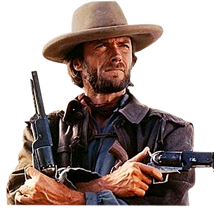
Westerns
Stories are set in American West
between the time of the Civil war and the early twentieth century
Notes:
Stories in the Western genre are set in the American West, between the time of the Civil war and the early twentieth century. The setting of a wilderness or uncivilized area is especially important to the genre, and the setting is often described richly and in-depth. They focus on the adventure of the main character(s) and the contrast between civilization or society and the untamed wilderness

Slide 18
Thanks for watching
Types of Films
Povilas Tamulis and Rytis Skipskys
-
May, 2017
Films
3

Slide 19
Mazeikiai Gabijos gymnasium, lt

