Slide 1
Types of Films
Project f.i.l.m.

Slide 2
Content
What is A film?
History
Genres

Slide 3
What is a film
Event or a story recorded using a camera that takes 24 to 48 pictures per second (also known as frames).

Slide 4
History
The first film ever made was “The Horse In Motion” 1878.

Slide 5
Genres
Action
Adventure
ANIMATED
BIOGRAPHY
CARTOONS
Comedy
Crime
DETECTIVE
DIISASTER
DOCUMENTARY
DRAMA

Slide 6
Genres
EPICS/HISTORICAL
FANTASY
HORROR
MARTIAL ARTS
MUSICALS/DANCE
ROMANCE/LOVE STORY
ROMANTIC COMEDY
SCIENCE FICTION
THRILLER
WAR FILM
WESTERNS

Slide 7
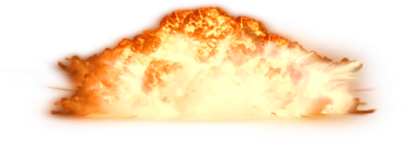
Action
protagonist usually takes a risky turn, which leads to desperate situations
includes explosions, fight scenes, daring escapes, etc.
Notes:
An action story is similar to adventure. Action and Adventure are usually categorized together (sometimes even as "action-adventure") because they have much in common, and many stories fall under both genres simultaneously (for instance, the James Bond series can be classified as both).
Sub genres:
Military fiction: A story about a war or battle that can either be historical or fictional.
Spy fiction: A story about a secret agent (spy) or military personnel member who is sent on a secret espionage mission.

Slide 8
Adventure
protagonist journeys to epic or distant places to accomplish something.
Very open Genre
Notes:
It can have many other genre elements included within it. Great adventure genre example is Indiana Jones.

Slide 9
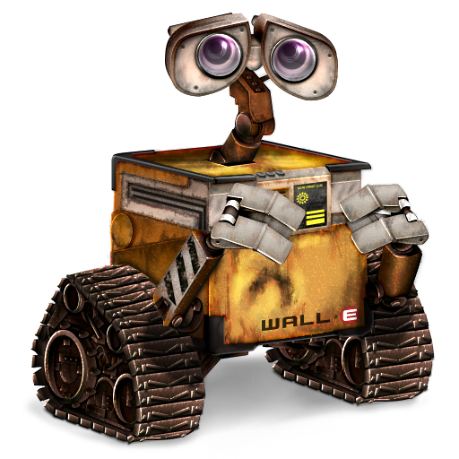
Animated
Traditional animation
Stop motion
Computer-generated imagery
Notes:
Traditional animation: is one of the oldest animation subgenres. Basically, it is a way of animating a cartoon by drawing and painting pictures by hand. Each drawing or painting is a different frame of animation, and when they are flipped or put in sequence at the right speed, they give the illusion of movement.
Stop motion: similar to traditional animation; instead of using hand drawn pictures, stop motion films are made with small figurines or other objects that have their picture taken many times in order to provide the animation frames.
Computer-generated imagery (CGI): A genre of animation that includes animating a cartoon on a computer modeling program. Models of characters or props are created on the computer, and then programmed to do something specific. Then, when the animation is completely programmed, the computer can play a completely computer generated movie. CGI is often used for the visual effects in Live Action films as well.

Slide 10
Biography
The details of the life story of a real person
Autobiography: the story is written by the subject of the story
Notes:
Biography: The details of the life story of a real person, told by someone else.
Autobiography: Essentially the same as a biography, with the exception that the story is written by the person who is the subject of the story.

Slide 11
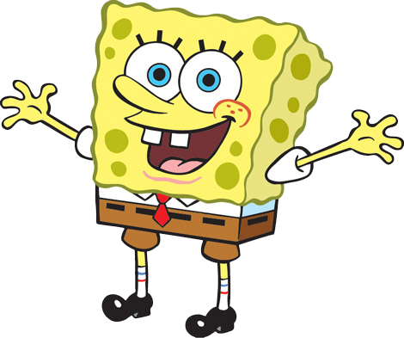
Cartoons
Humorously exaggerated characters
uses animation techniques to photograph a sequence of drawings
Notes:
Cartoon basically refer to two things. It can either refer to a simple, non-realistic, drawing depicting a humorous situation or humorously exaggerated characters.
Cartoon can also refer to a short film or television show that uses animation techniques to photograph a sequence of drawings rather than real people or objects.

Slide 12
Comedy
intended to make the audience laugh
Very open Genre
Notes:
Comedy is a story that tells about a series of funny or comical events, intended to make the audience laugh. It is a very open genre, and thus crosses over with many other genres on a frequent basis.

