Slide 1
Make – up for actors/ actresses
April, 2018

Slide 2
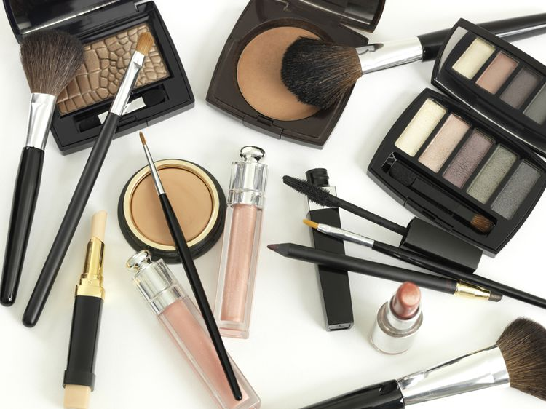
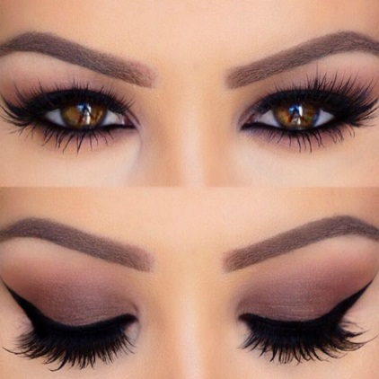
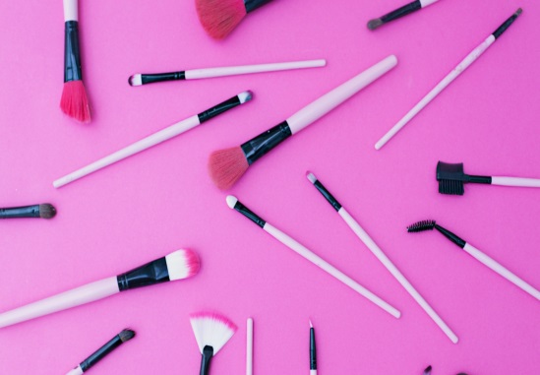
Content
Types of Make–up.
About stage make–up.
Stage make-up for men. TIPS.
Stage make-up for women. TIPS.
Special effects make–up.
10 steps how to do special effects make–up.
Some videos.
Actors before and after applying special effects
make–up.
Project members before and after applying
special effects make-up.

Slide 3
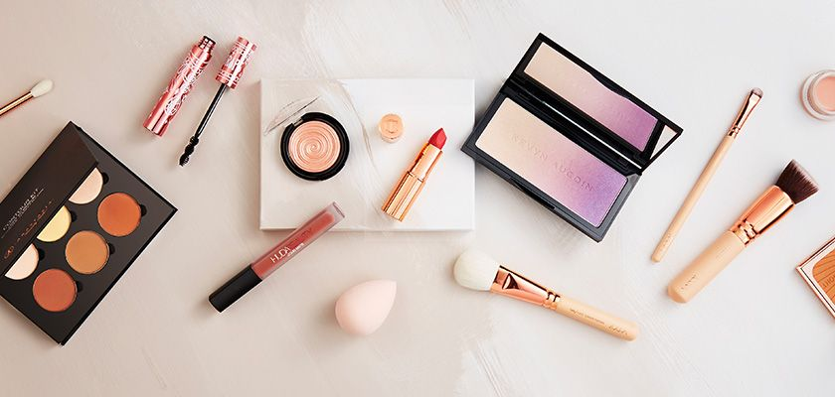
Types of make–up
Movie make-up ranges from simple applications (No
make-up or Stage make-up) to complex monster looks (Special effects make-up).

Slide 4
No make-up or Stage make–up

Slide 5
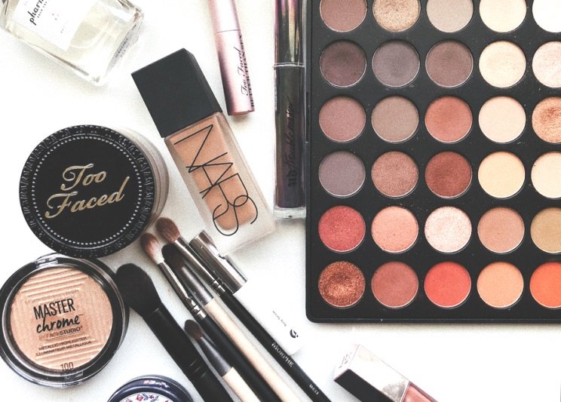
About stage make-up
It does not look like a person is wearing make-up.
It is used to correct the distortions caused by the camera lens and lights.
It is used to bring out natural features and cover up blemishes.
Concealer, eyeliner and mascara, setting powder or pressed powder and a lipstick that is a few shades darker than the natural lip colour
are used for make-up.

Slide 6
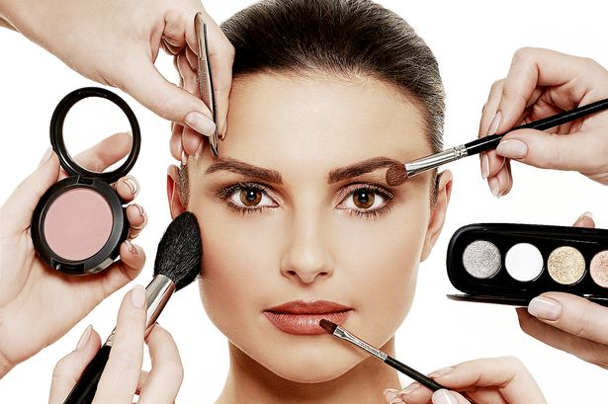
Warm colors are the best for the film. Cooler colors are exaggerated on camera.
Matte and neutral hues should be used.
High-shine should be avoided.

Slide 7
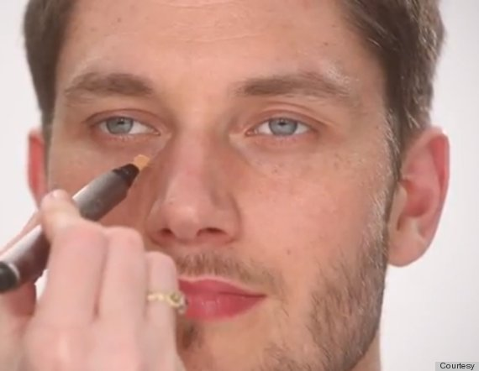
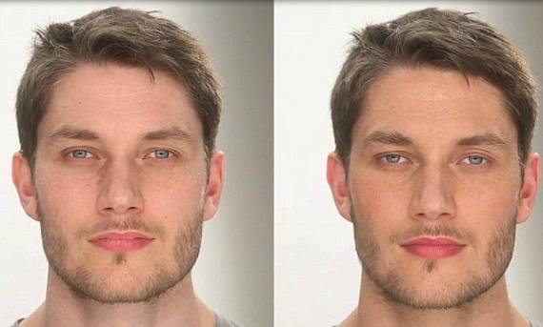
Stage make-up for men. TIPS.
Use powdered make-up. It helps to prevent light from bouncing off of them
Use evening out skin tone, covering blemishes and eliminating any shine or reflection.

Slide 8
Stage make-up for women. TIPS.
Accentuate certain features so that you would not look too colorful as natural look is suggested.
Go for slight exaggeration – don’t overdo it.
Use real stage make-up, real greasepaint. It will help to stand up to the heat of the lights and the stress of performance.

Slide 9
Special effects make–up

Slide 10
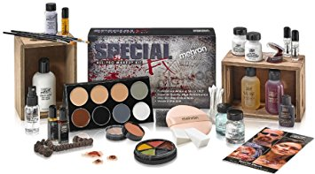
About special effects make–up
It is used to make actors look scary, beat-up or inhuman.
It takes up much time to use cosmetics and appliances to create the appearance of bruises, cuts, blood, old age, deformities or mutations.

Slide 11
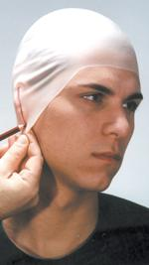
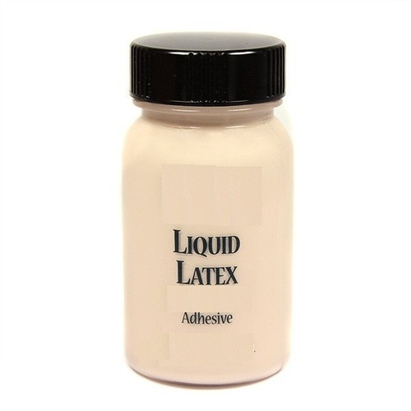
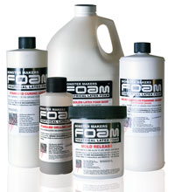
About Special effects make–up
Make-up is created with the help of basic materials such as:
Liquid or Foam Latex
Silicone
Bald Cap
Spirit gum
Modeling clay
Gypsum cement
Plaster bandages
Make-up removal

Slide 12
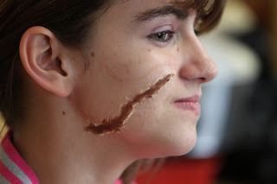
10 steps how to do special effects make-up
1. Apply a primer. It will create a base.
2. Plot out the shape of the scar you want to create using a white pencil.
3. Start building the edges of the scar using the wax.
4. Using a make-up sponge, apply liquid latex over the wax.
5. Apply matching foundation over the fake skin to make it look more realistic.
6. Fill in the open gash with a dark brown eye shadow.
7.Build on the dark brown with a black eye
shadow. Patches of colour will make it look
as if the wound has different depths.

Slide 13
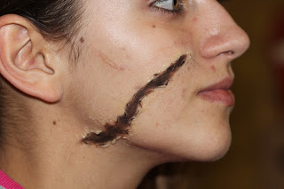
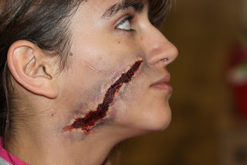
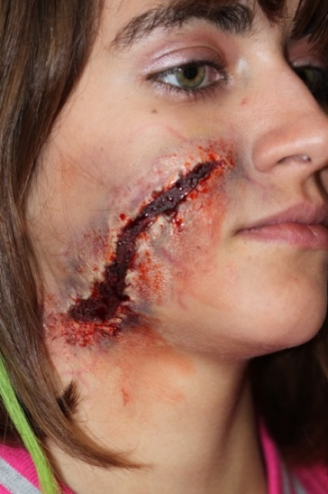
8.Use a deep red lipstick.
9.Apply some brown eyeshadows around the outer edges of the 'wound'. Build on this with blues, purples, yellows and greens.
10. Take thick fake blood and add some of it into the wound. Add some of the runny stage blood next. It will make the wound look more realistic. Create blood spray. Then take a sharp red lip liner, lightly draw in some veins around the wound.

Slide 14
How movie monsters are made?
https://www.youtube.com/watch?v=Bax9LAXej4A

Slide 15
Scrapes special fx makeup tutorial
https://www.youtube.com/watch?v=xA80FJEeH50

Slide 16
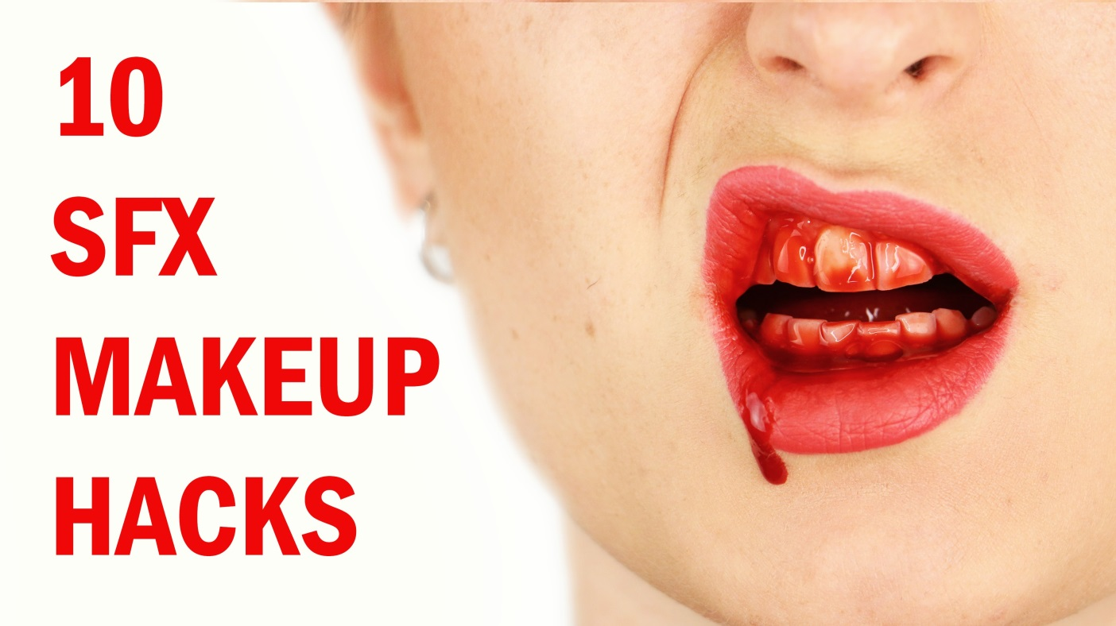
Top 10 SFX makeup hacks
https://www.youtube.com/watch?v=5-ZYWbYIse4

Slide 17
Actors before and after applying special effects make-up

Slide 18
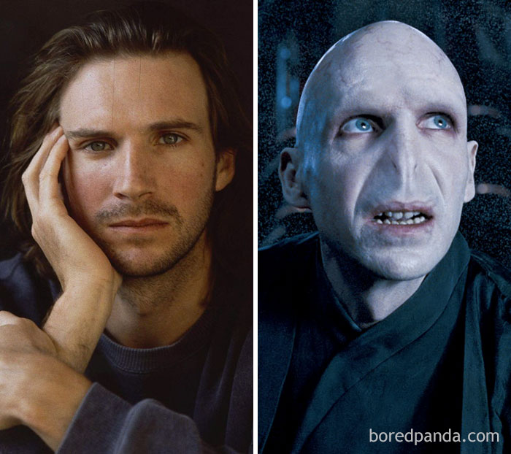
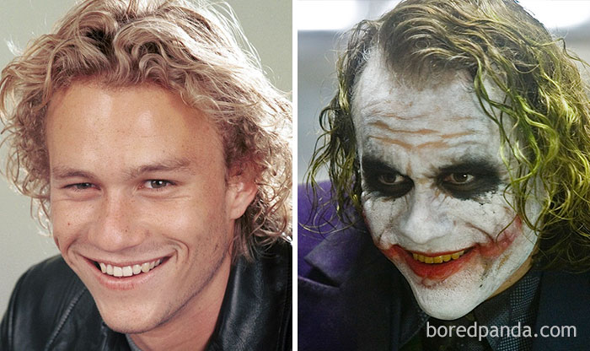
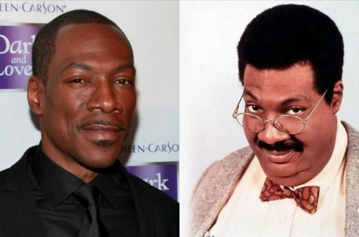
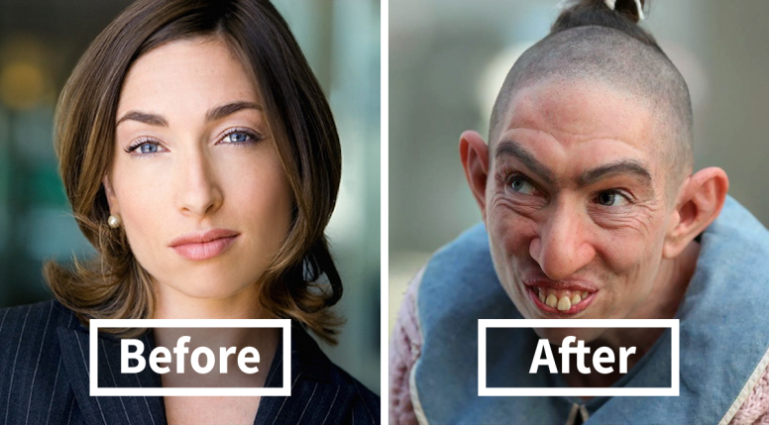
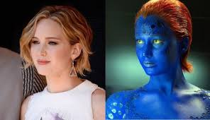
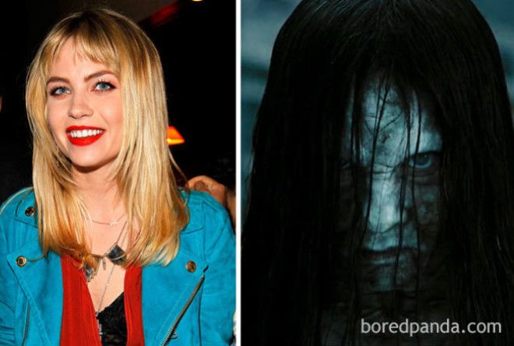
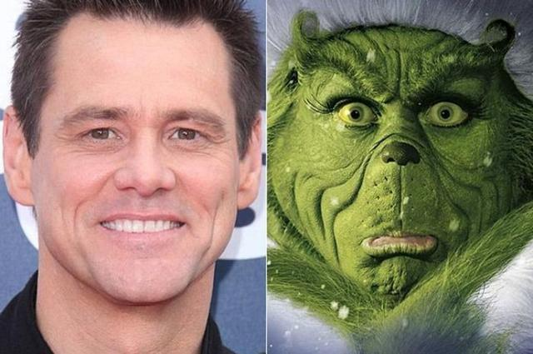
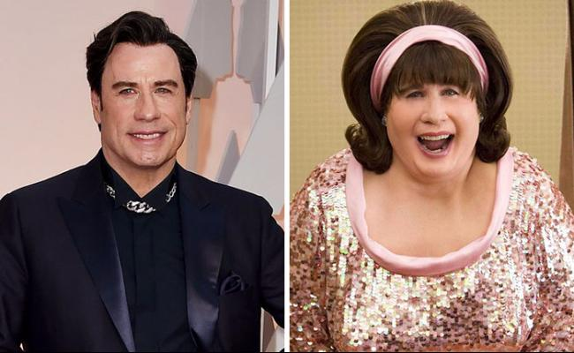

Slide 19
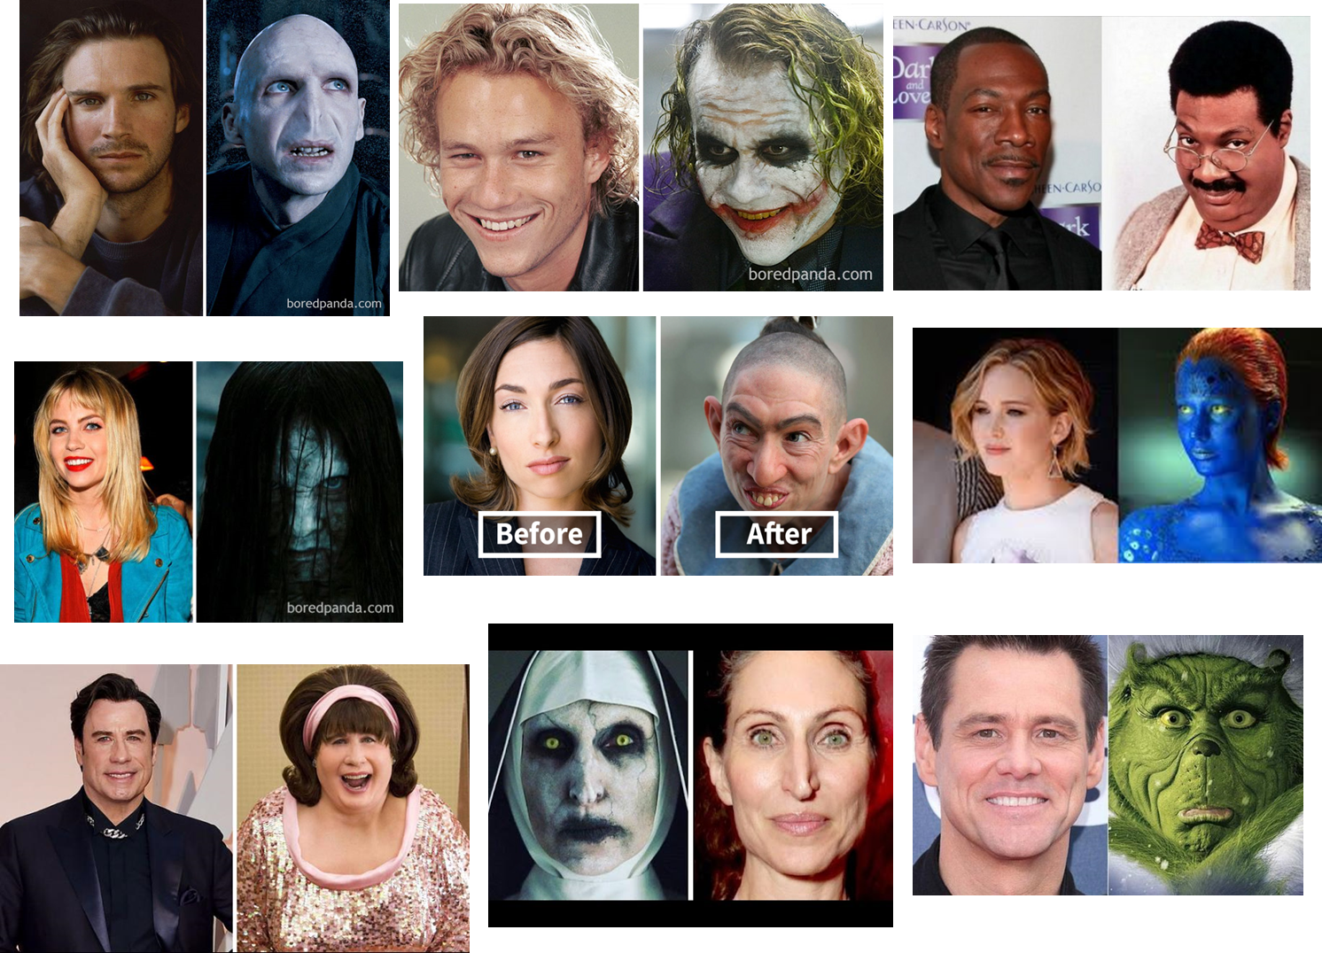
Ralph Fiennes - Lord Voldemort (Harry Potter Series)
Heath Ledger - Joker (The Dark Knight)
E.Murphy – Sherman Klump ( The nutty professor)
Jennifer Lawrence - Mystique (X-Men: Days Of Future Past)
Naomi Grossman - Pepper (American Horror Story Series)
Daveigh Chase - Samara (The Ring )
Jim Carrey - The Grinch (How The Grinch Stole Christmas)
John Travolta - Edna Turnblad (Hairspray)
Bonnie Aarons - Valak (The Conjuring 2)

Slide 20
Project members before and after applying special effects make-up

Slide 21
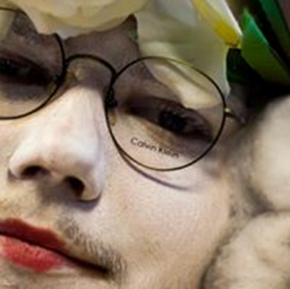
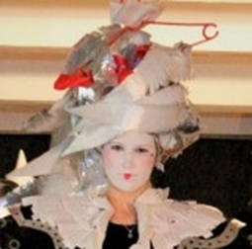
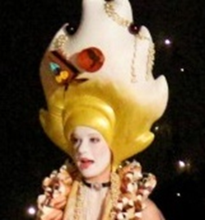
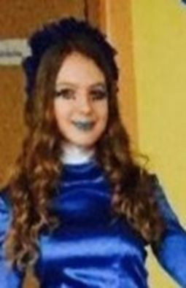
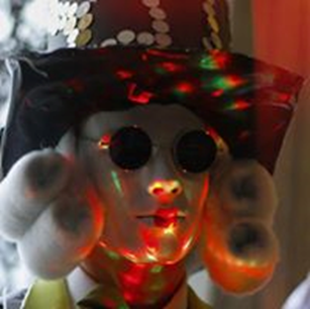
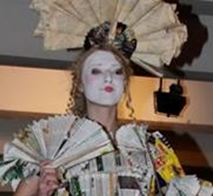
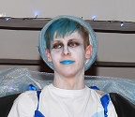
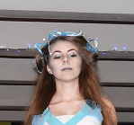
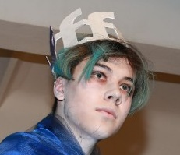
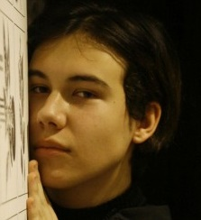

Slide 22
We are ready for Make-up☺

Slide 23
Thanks for watching
Done by GRETA and VINCENTAS
Mažeikiai
Gabija gymnasium
Lithuania

