Slide 1
Hardware and software used for creating films

Slide 2
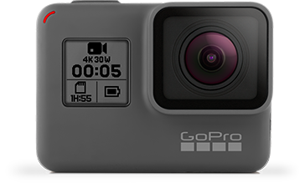
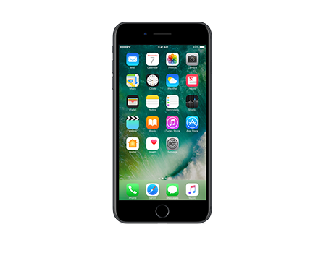
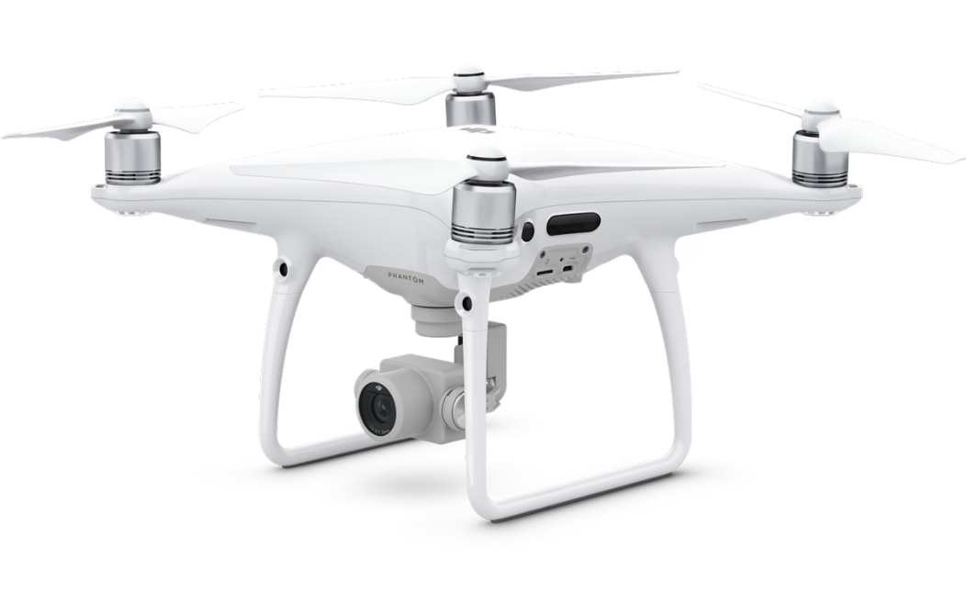
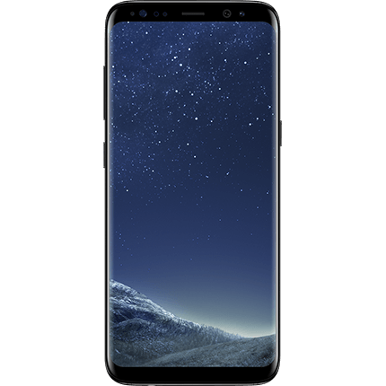
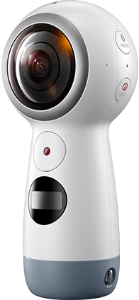
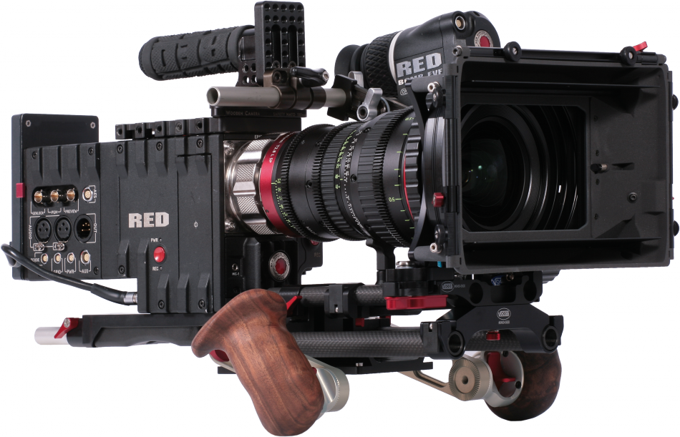
Examples of different cameras

Slide 3
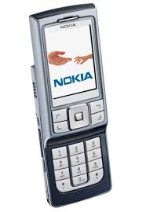
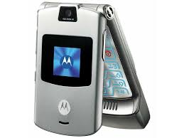
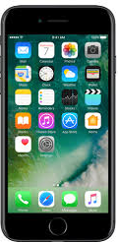
Hardware - Mobile phones

Slide 4
Content (1)
Hardware - Mobile phones:
1.Some historical facts about:
The Telephone
The Mobile phone
The Smartphone
2.The main qualities of the smartphone
3.Camera
4. The usage in filming
5.Pluses
6.Minuses

Slide 5
The telephone
It is a telecommunications device that allows two or more users to make a conversation when they are too far apart to be heard directly.
People say that the person who invented the telephone was Alexander Graham Bell in 1897.

Slide 6
The mobile phone
It is a portable telephone that can make and receive calls while the user is moving within a telephone service area.
Martin Cooper made first mobile phone in 1973.

Slide 7
The smartphone
It is a mobile personal computer with features useful for mobile or handheld use.
The beginning of the smartphone is considered to be in 2007.
It has a number of useful features.

Slide 8
The main qualities of the smartphone
Messaging
Web browser
Voice-based features
Multi-touch
Multitasking
Screen capture
Video calling
Multiple language support
External storage
A great quality camera

Slide 9
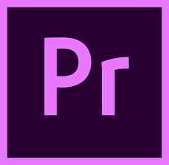
One of the features – a camera
A smartphone usually has a camera which lets everyone make good videos.
There are some useful apps used for editing, for example, Adobe Premiere Pro.

Slide 10
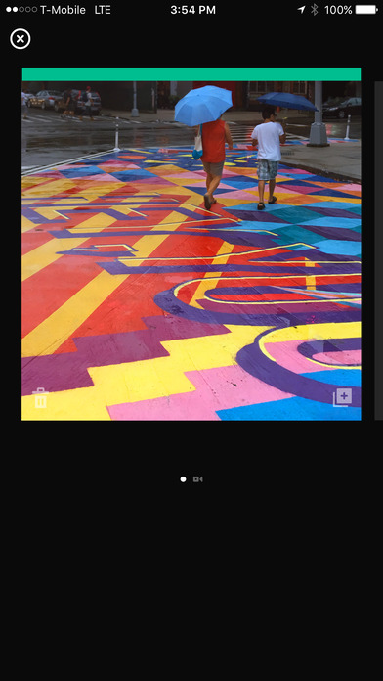
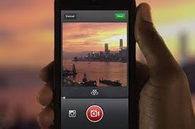
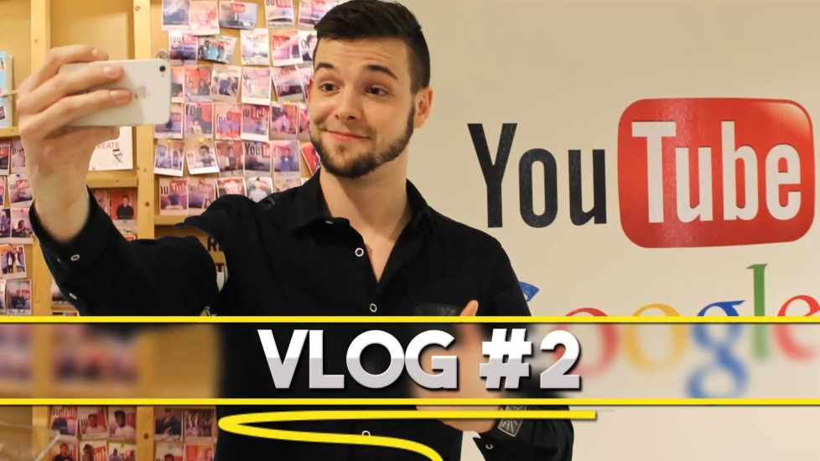
The usage in filming
Smartphones are used to shoot short films.
Examples:
„Vine“ videos, vlogs and short skits on „Youtube“, „Facebook“ and „Instagram“

Slide 11
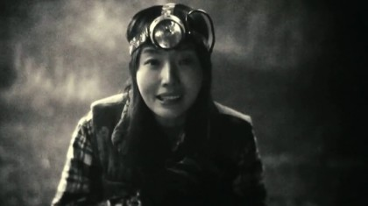
The usage in filming (1)
Some of them have become famous and even got a cinema release
Examples:
Night Fishing, shot on an iPhone 4
Tangerine, made using iPhone 5s handsets

Slide 12
+ Pluses +
It is much easier and more convenient to film than with the help of a traditional camera.
You have all necessary equipment in one place (your phone).
The editing is fairly simple.
The phone itself is cheaper than a good camera.

Slide 13
- Minuses -
The smartphone is not designed for filming long and big videos.
The quality of the video is not as high as it is done with a filming camera.
If you want to shoot more serious, longer and professional films, then a smartphone is not the way to go.

Slide 14
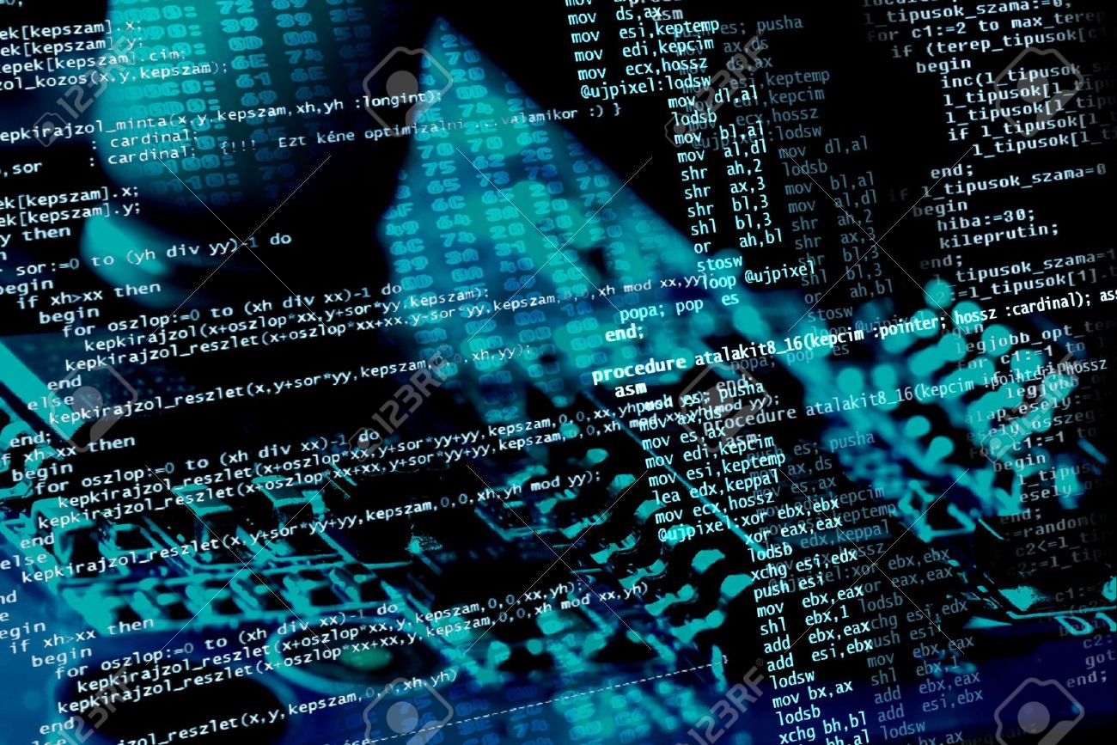
SOFTWARE

Slide 15
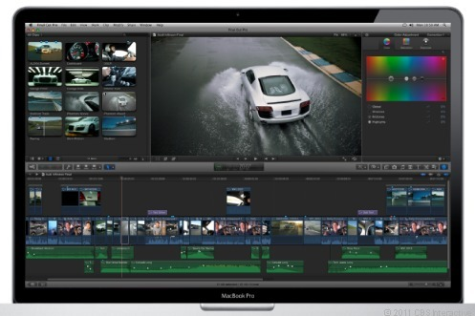
Software
The best editing software (from the easiest to use to the most professional one):
Windows Movie Makers (good for short editing)
Filmora (good for longer movies)
Adobe premiere (one of the best ones used by professionals)

Slide 16
Content (2)
Software - Adobe premierE
What is Adobe Premiere?
Features
The usage in the film industry
Pluses
Minuses

Slide 17
What is Adobe Premiere?
Adobe Premiere Pro is the newest edition of a timeline-based video editing app developed by Adobe Systems and published as part of the Adobe Creative Cloud licensing program.
First launched in 2003, Adobe Premiere Pro is a successor of Adobe Premiere (first launched in 1991).

Slide 18
Features(1)
Since its debut in 1991, Adobe Premiere has evolved and improved drastically, with added new functions every new version released.
The newest Priemiere’s Pro’s features include:
Support of high resolution video editing, Audio sample-level editing, VST audio plug-in support, and 5.1 surround sound mixing.

Slide 19
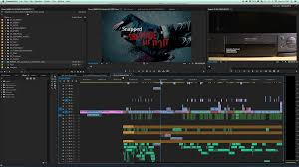
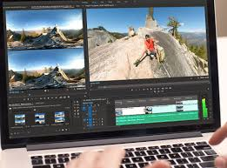
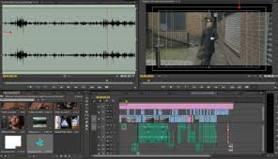
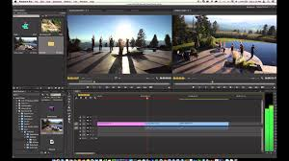
Features(2)
Also, Premiere Pro's plug-in architecture enables it to support a wide variety of video and audio file formats and codecs on both MacOS and Windows.

Slide 20
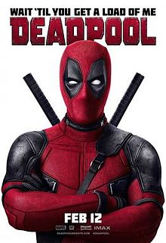
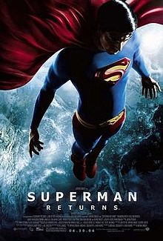
The usage in the film industry
Lots of films are edited while using that program.
Some of them have become box office hits. Deadpool, Avatar, Superman returns, The social network.

Slide 21
+ Pluses +
This software is top-notch.
By using it, your edited movies will look better than ever.
It has a lot of features to offer for a user.

Slide 22
- Minuses -
The full version costs a lot.
The pro version is not accessible to the average user.
It will take time before you get the hang of the program.
The software needs a powerful computer so that it could run properly.

Slide 23
Conclusion
The phone is a perfect invention. Let’s say THANKS to A.G.Bell.
This year we are celebrating the 120th anniversary of the phone.
Nowadays the mobile phone or the smartphone is a unique device which has a lot of functions.
Have fun while using it☺

Slide 24
Mazeikiai Gabijos gymnasium, Lithuania

Slide 25
Thanks for watching!

Slide 26
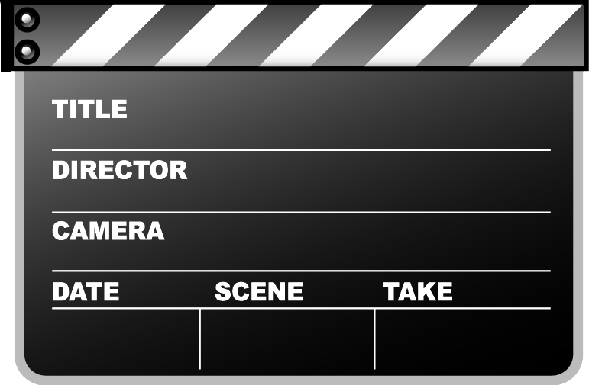
Hardware and software
Deividas, Edgaras, Egle and Ieva J.
-
June, 2017
Films
4

