Slide 1
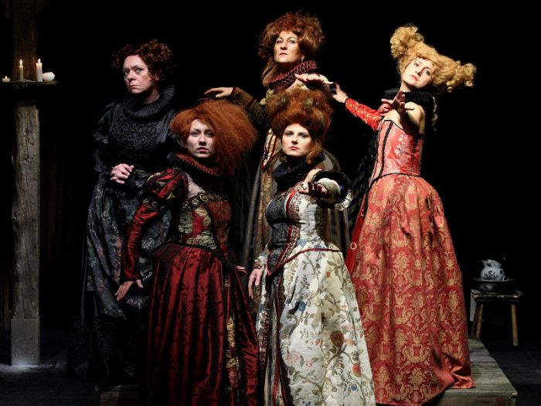
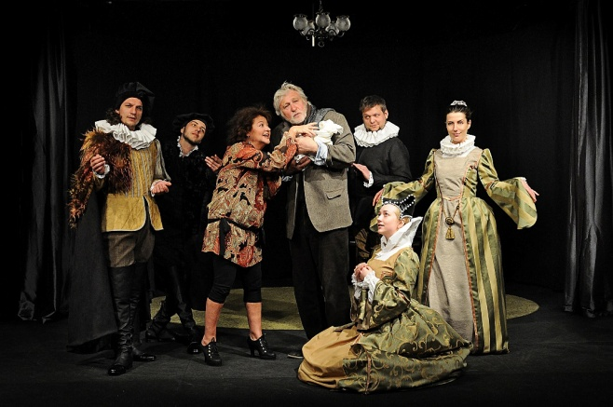
How costumes are made for actors
Sara Miernik IA

Slide 2
The importance of the costume the theater
Acting is a difficult art, requiring incredible creativity and commitment from the person practicing it . Furthermore the actor, while on stage, works exclusively on the basis of his own resources: face exprecion, gestures and voice. The theatrical costume is actually the only external attribute, therefore, it is very important that the stage clothing enabled the realization of the artistic concept of the spectacle.

Slide 3
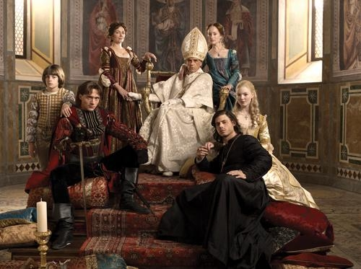
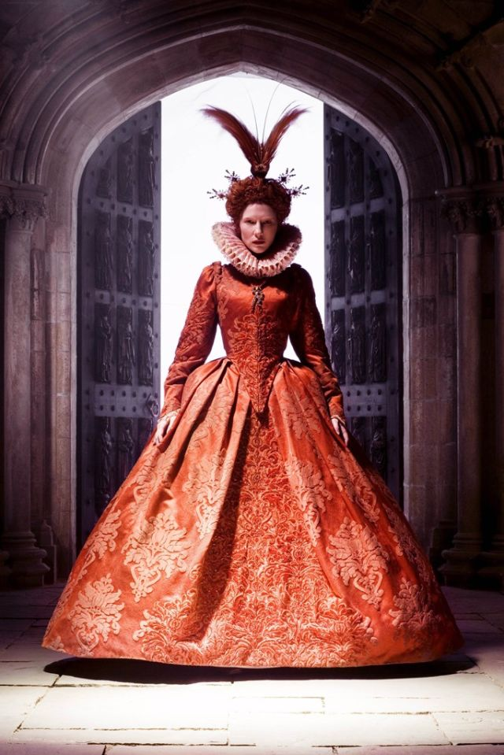
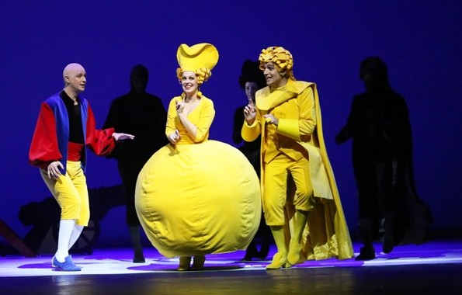

Slide 4
Costume design-at the beginnig was a scenario
The most important issue in costume designing for the needs of the performance is familizarization with the climate of the script and discussing expectations with the stage manager. On this basis the costume-designer can start conceptual work.

Slide 5
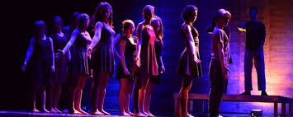

Slide 6
Costume design
Depending on the time and age, proper research is often necessary: analysis of old recordings, review of photos or articles in archives or libraries. After the project has been prepared, further consultations are held, which allow for necessary modifications in advance.

Slide 7
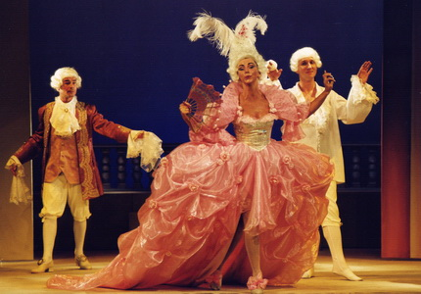
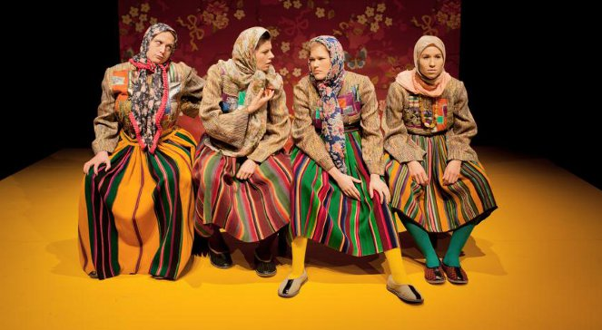

Slide 8
Sewing Costumes
When the final costume design is prepared, it goes to the tailor. The cooperation between the costume designer and the tailor needs to be smooth and an important step is also the joint selection of materials. Sometimes the external company is responsible for all the work on the costumes, which facilitates communication at this stage.

Slide 9
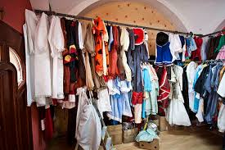
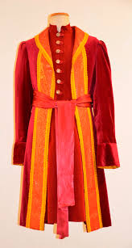
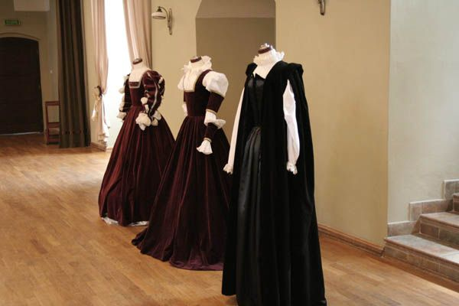

Slide 10
Sewn Costume isn’t the end of work
The finished costumes are transferred to the theater, where the fittings are carried out. Various modifications are still possible. By adding subtle details, you can highlight selected aspects of a given actor's role, or highlight important character traits.

Slide 11
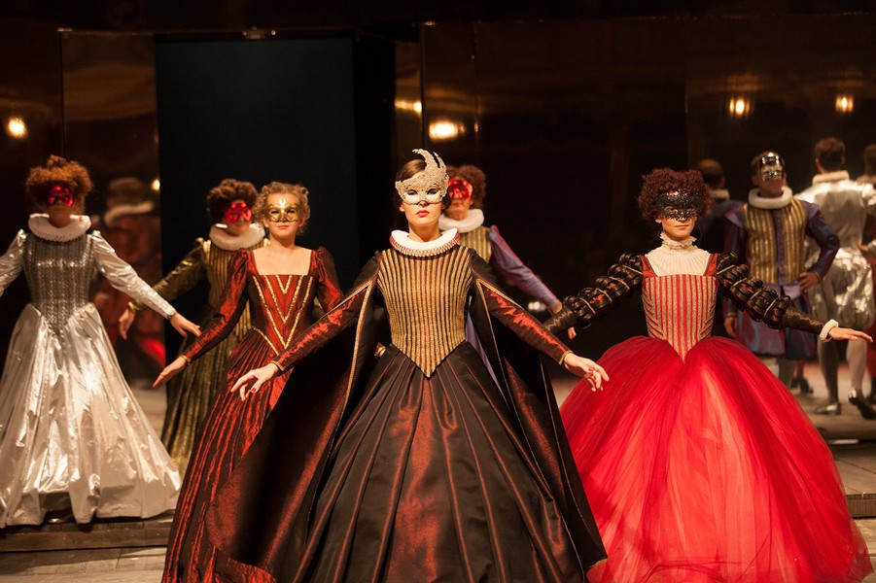
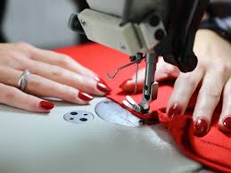
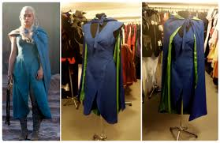
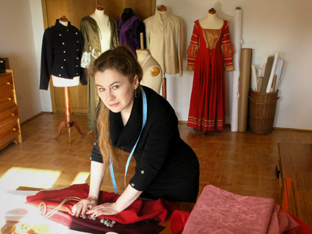

Slide 12
Sewn Costume isn’t the end of work
Also the actors themselves often report corrections and comments about to theatrical costumes, what usually are causes disputes in the theatrical wardrobe. Their positive solution depends on the diplomacy of the costume designer and his ability to ... make small concessions.

Slide 13
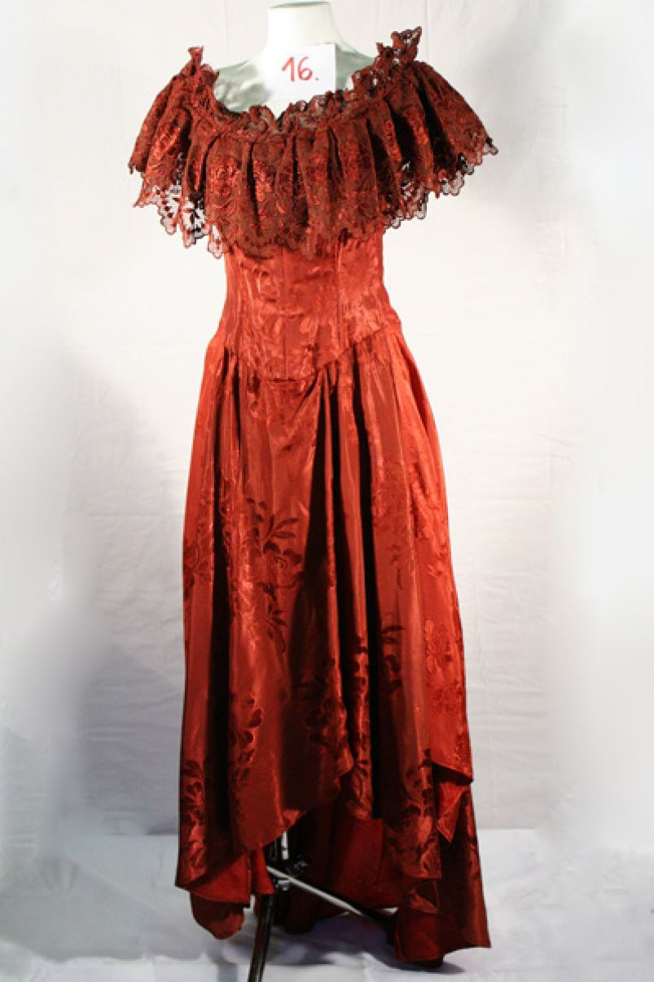
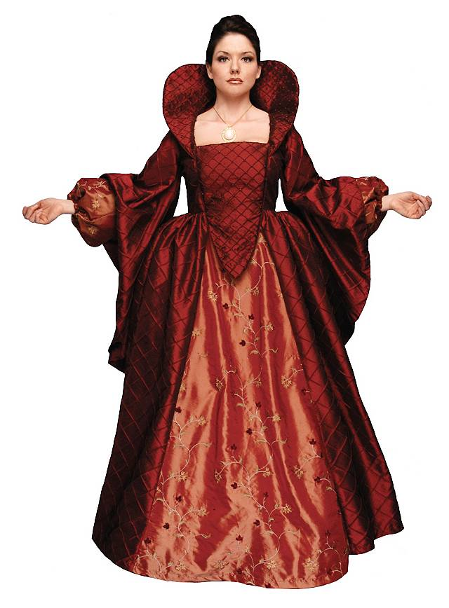

Slide 14
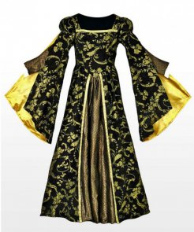
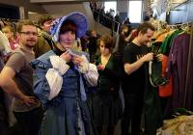
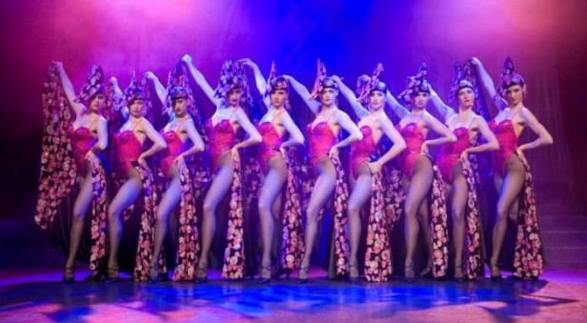
The End

